Slide 1

Student Housing
By
Kristiyan Balev (460703)
Stanislav Petkov (4222024)
Stefan Pricopi (4094611)
Stefan Popescu (4186354)

Slide 2
Introduction/Background
Student Housing BV are a student housing company that are renting out rooms with shared facilities for students during their studies in the Netherlands. It appears though, that the many of the tenants in the company’s housing facilities are unsatisfied and annoyed with each other, that’s why the company has tasked us with creating and developing an application that can solve the issues that the students are having to deal with, such as unannounced parties, not cleaning the garbage on time, etc.

Slide 3
Problems stated/Goal
The agency has been receiving complaints for some time now from their clients. Some of the complaints are related to:
- People not cleaning the shared facilities after using them.
- Some people not paying for groceries and shared items.
- Not cleaning the garbage on time.
- Having unannounced parties or gatherings.
- Noise complaints.
-etc.
These are only a fraction of the complaints that the clients have, so our goal is to make a software that allows people to have a space where they can record them and do more(for example agreements, have suggestion for changing/adding rules, etc.)

Slide 4
Functionality
In order to fix the problems stated before, we decided to implement the following ideas:
- Record and set agreements between students - Tenants
- Collecting and recording complaints from the students - Admins
- add/update/change the rules/view student suggestions - Admins
- File complaints (can be done anonymously) - Tenants
- Schedule events – Tenants
-Being able to add/remove students from the house - Admins

Slide 5
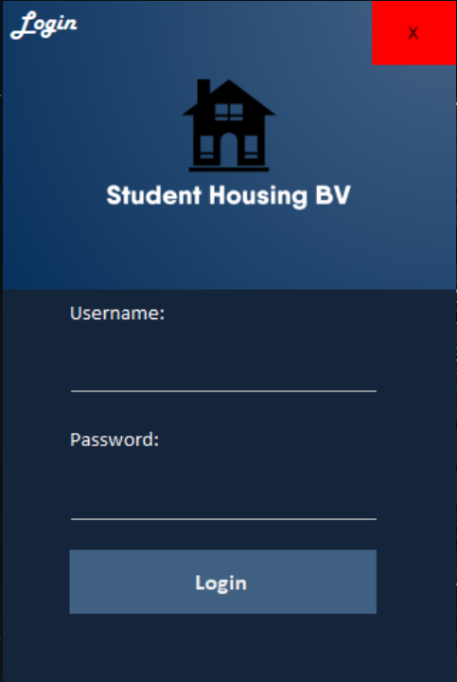
Login Form
In the beginning the user is supposed to choose from 2 options, either log in as a tenant or as an admin, opening either the admin form or the tenant form.

Slide 6
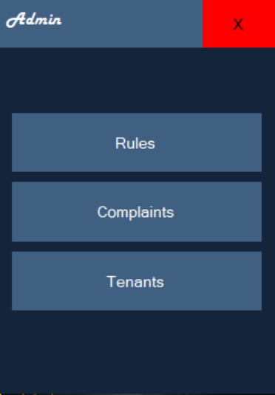
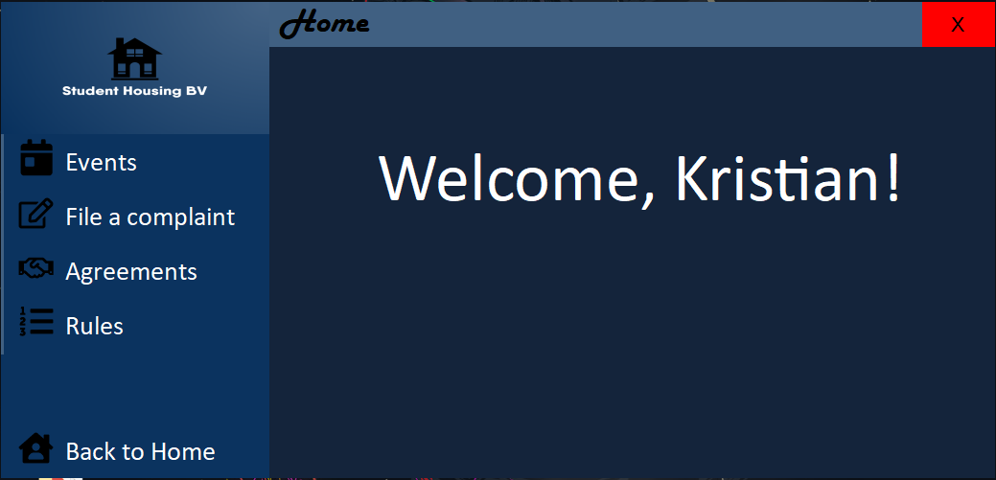
Tenant/Admin Form
According to the registration credentials the user will either enter the app as an admin or as a tenant:
Admin form
Tenant form

Slide 7
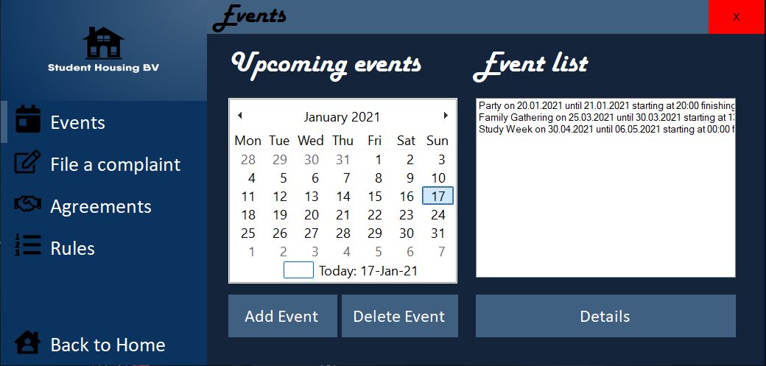
Tenant Form
In the tenant form the user encounters 4 tabs to choose from depending on the problem he wishes to solve, either Events, Complaints, Agreements and Rules.
- Event tab:
In the event tab the student can see the events that are going to happen and he’s also able to add or remove an event by selecting the it from the list.
By pressing the details button the student can see the full description of the event selected from the list, including the start hour, finish hour, number of people.

Slide 8
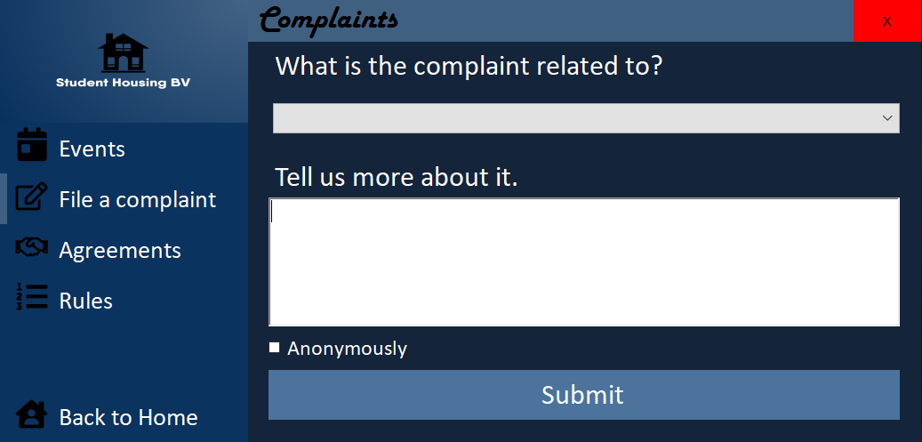
- Complains tab
In the complains tab the student can select a complain category and submit it with an additional message describing the problem more in depth. He can also decide if he desires the complain to me made anonymously or not.

Slide 9
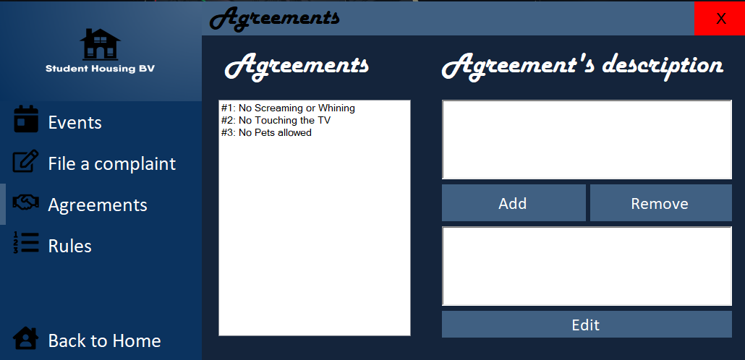
- Agreements tab
In the agreements tab the student can see the agreements that were previously made and such he can add/remove/edit any of them.

Slide 10
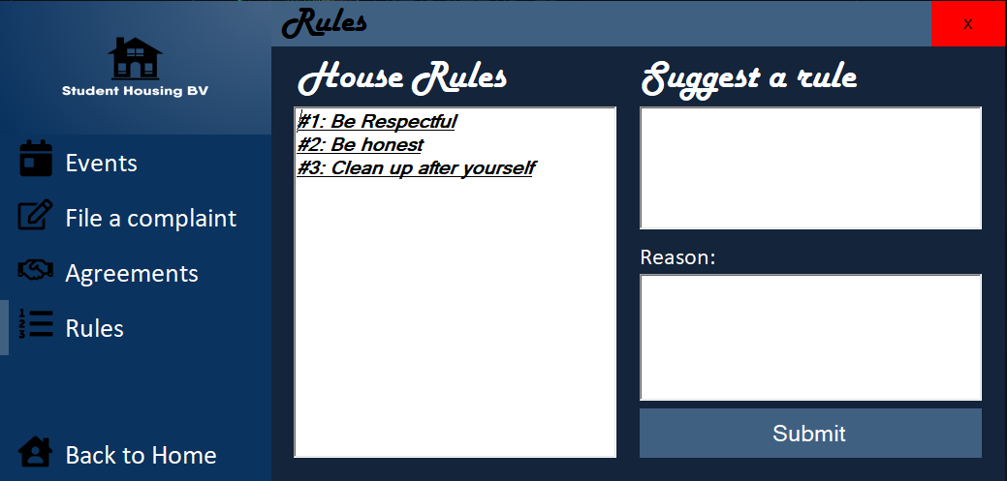
- Rules tab
In the rules tab the student can see the rules made by the student housing and in addition to that he can suggest a rule, explaining the reason why he wants that specific rule.

Slide 11
Admin Form
In the admin form the admin encounters 3 buttons to choose from depending on the problem he wishes to solve, either about Rules, Complaints or Tenants.

Slide 12
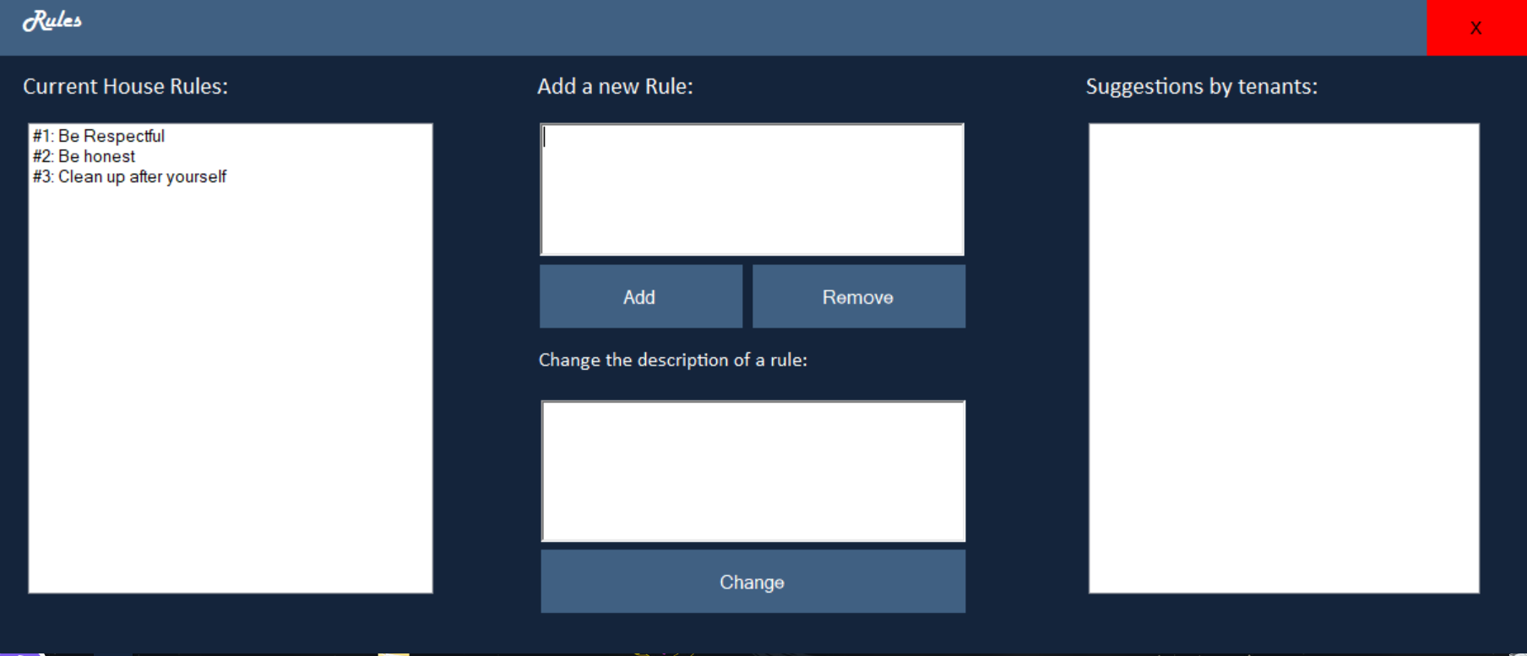
- Rules tab
In the rules tab the admin decides which of the suggested rules by the tenants get to be added to the official/accepted rules list.
He’s also able to remove or change any of the rules the wishes to or even add his own rule.

Slide 13
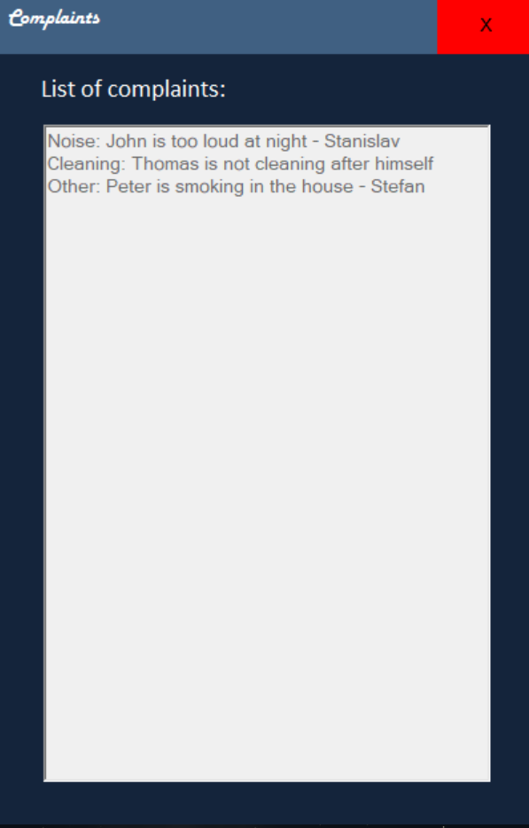
-Complaints tab
In the complains tab the admin can see the complains made by the tenants

Slide 14
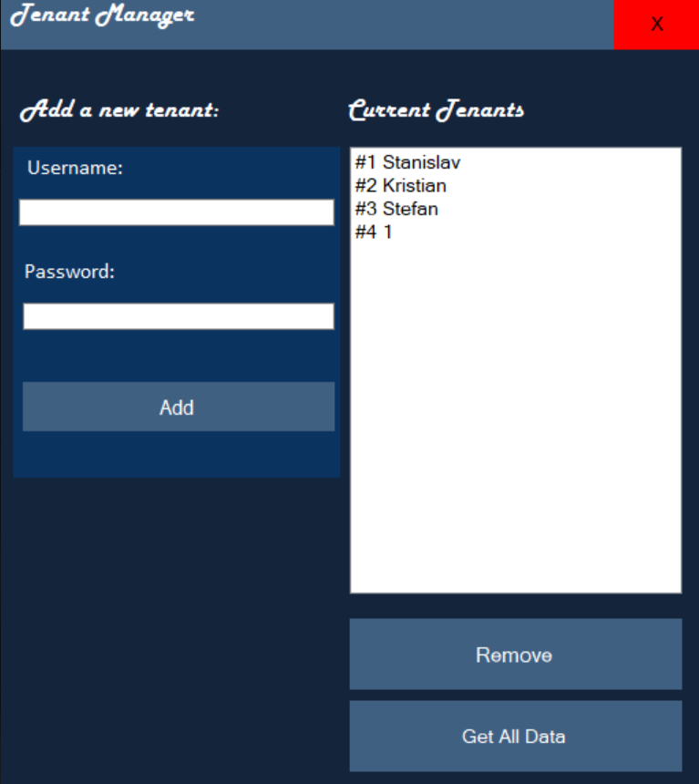
- Tenants tab
In the tenants tab the admin can see the existent students, to create new student accounts and delete them, when a tenant is kicked out of the house or his contract expired.
By clicking the “Get All Data” button the admin can see all the login credentials of the tenants that have been registered.

Slide 15

THANK YOU FOR YOUR TIME!
Have a nice day! <3

